Slide 1
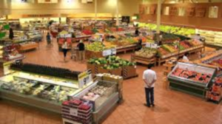
Grocery Store Management System
Project by:
Henal p. Mehta-202012005
Shobhit Saxena – 202012006
Pranay Joshi – 202012007
Lalit Kumar – 202012008
Vanditha Vinod – 202018003
P. Saran Pandian - 202018004

Slide 2
Functional Requirements
To retrieve the list of customers who have transactions more than Rs. X.
To retrieve the sales of a particular product for a given week.
To retrieve the income generated by online payment and cash separately.
Total due amount to be paid to each vendor.
To list the stores with customer flow in ascending order.
For all requirements, click here.

Slide 3
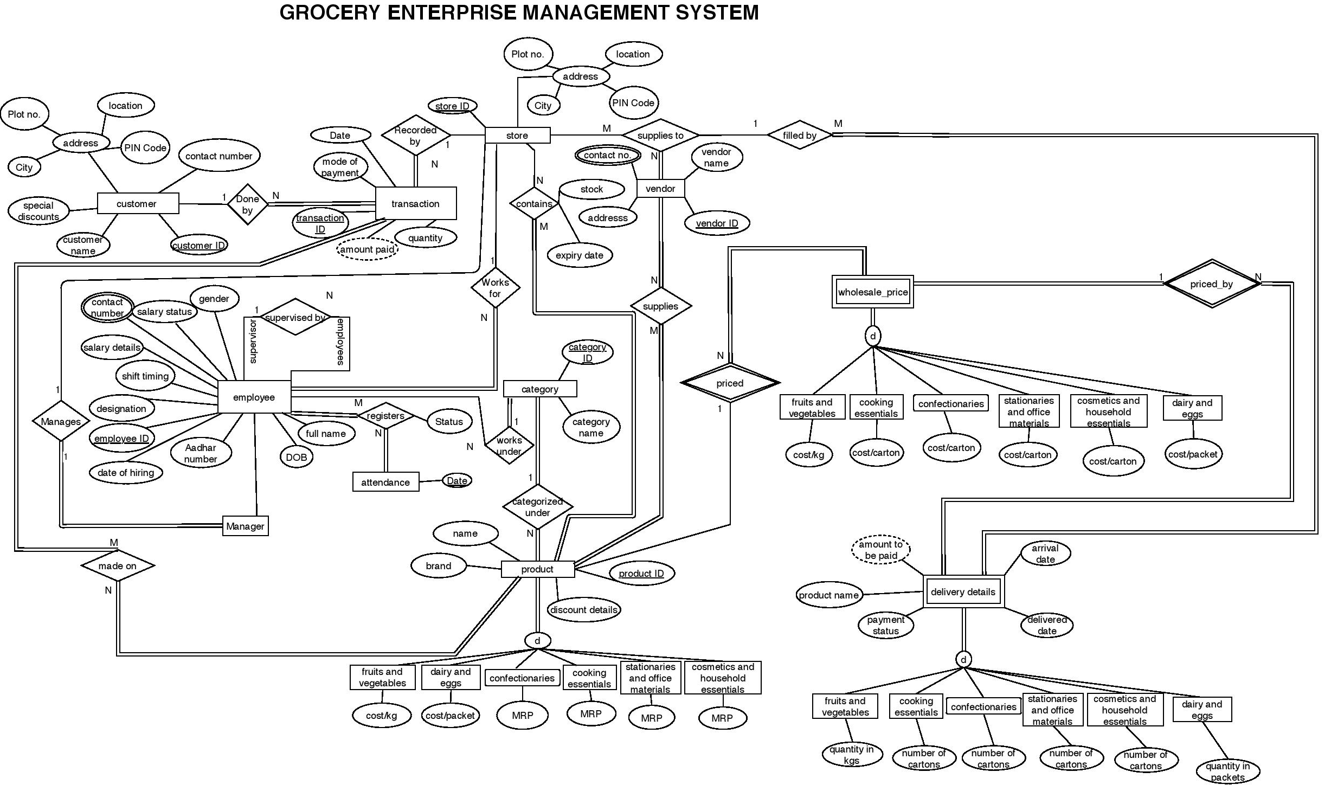
Click here to see the diagram before normalization.

Slide 4
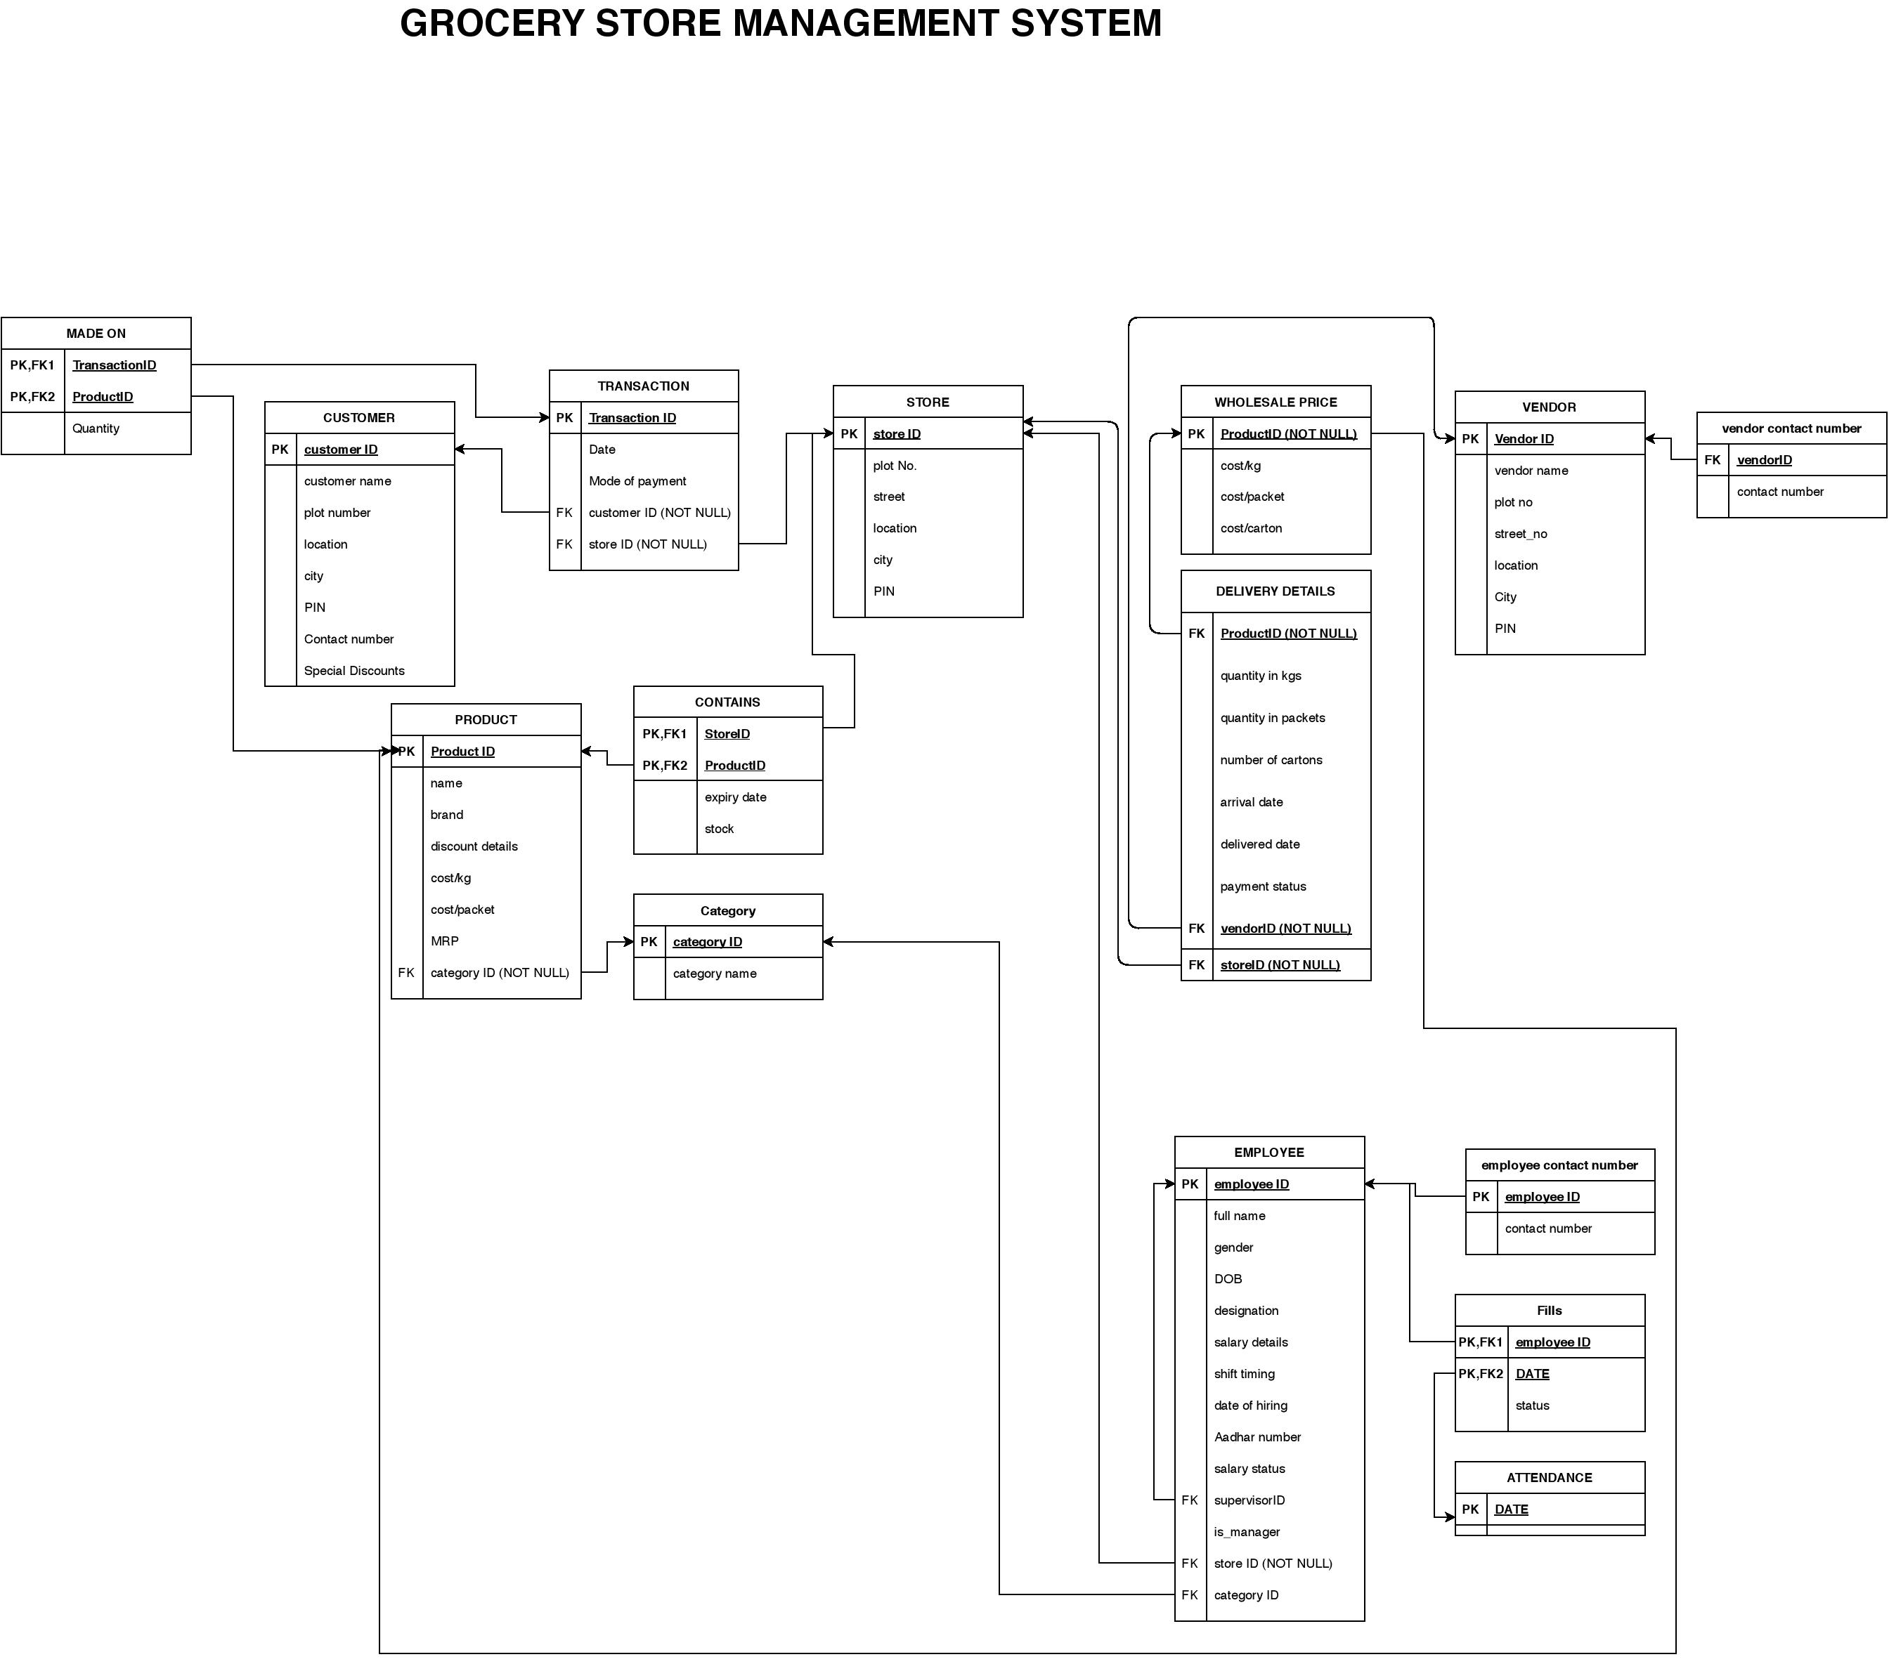
Click here to view
relational model before
normalization.

Slide 5
SQL DDL Statements
Click here to view constraints.
Click here to view all DDL Statements.

Slide 6
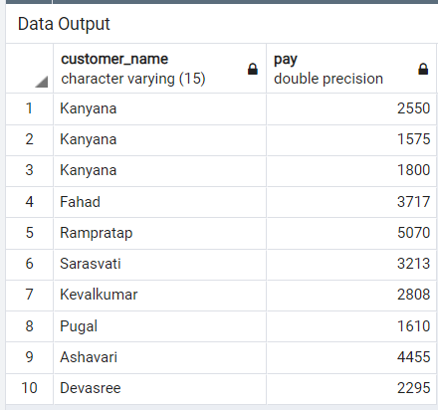
To retrieve the list of customers who have transactions more than Rs. X.
Click here to view DML Statements of this query.

Slide 7
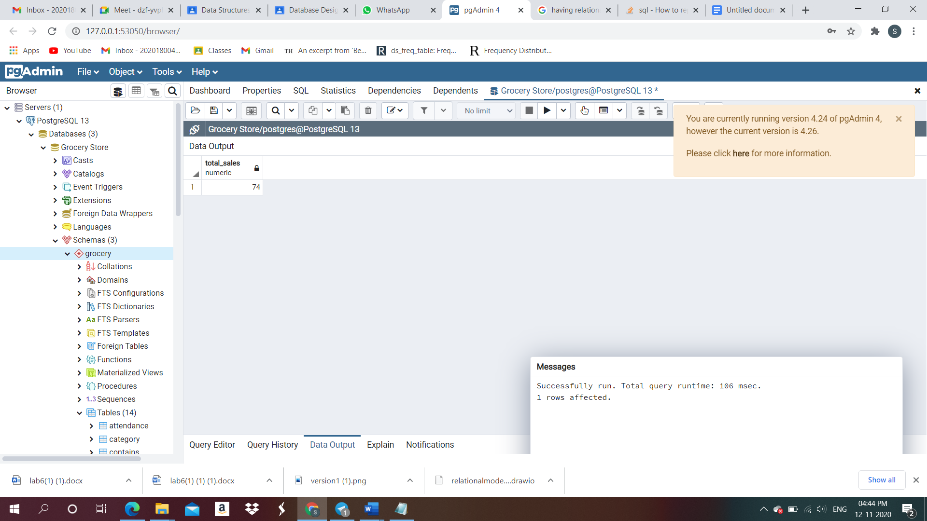
To retrieve the sales of a particular product for a given week.
Click here to view DML Statements of this query.

Slide 8
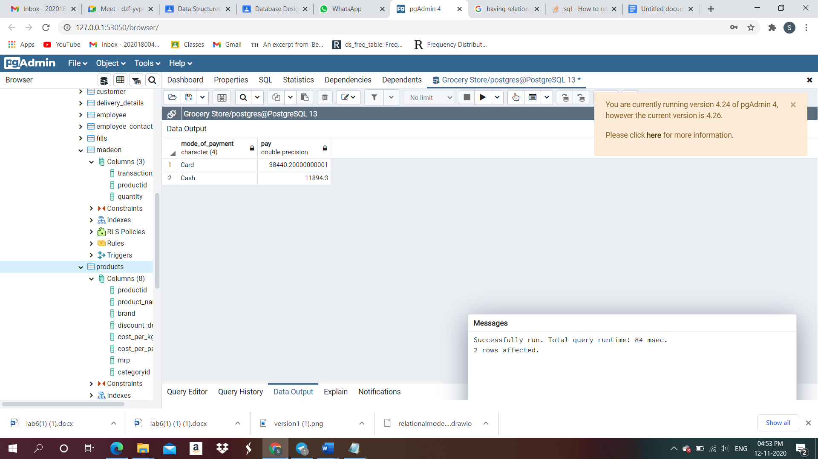
To retrieve the income generated by online payment and cash separately.
Click here to view DML Statements of this query.

Slide 9
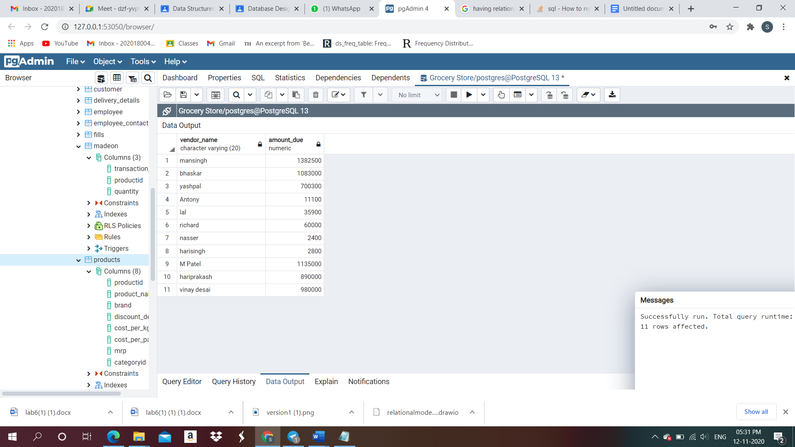
Total due amount to be paid to each vendor.
Click here to view DML Statements of this query.

Slide 10
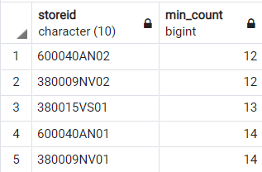
To list the stores with customer flow in ascending order.
Click here to view DML Statements of this query.
Click here to view DML Statements of all queries.

Slide 11
Conclusion
From this database, we can ensure the smooth functioning of the grocery enterprise.
We can ensure the products are fresh and in stock, the employees are regular and paid on time, the vendors deliver the products on time, and customer satisfaction is fulfilled.
One entity ‘Delivery Details’ had redundancy as it violated 2NF form, and was later decomposed into two tables, namely ‘Delivery Details’ and ‘Wholesale Price’. In conclusion, we can ensure all the tables are in BCNF.
Click here to view the FDs & normalization process.

Slide 12

Thank You!

